Slide 1




RETAIL SALES DATA ANALYSIS USING EXCEL
STUDENT NAME : S. SIDDARTH
REGISTER NO : 422200021
DEPARTMENT : B.com (ISM)
COLLEGE : S.I.V.E.T College-103

Slide 2
PROJECT TITLE
RETAIL SALES DATA ANALYSIS USING EXCEL

Slide 3


AGENDA
Problem Statement
Project Overview
End Users
Our Solution and Proposition
Dataset Description
Modelling Approach
Results and Discussion
Conclusion
3/21/2024 Annual Review

Slide 4

PROBLEM STATEMENT
As a retailer, we struggle to accurately forecast demand, manage inventory levels, and optimize pricing strategies, leading to:-
Stockouts and lost sales
Overstocking and waste.
Missed opportunities for revenue growth.
Inefficient allocation of resources.
We need a data-driven solution to analyze our sales data, identify trends and patterns, and provide actionable insights to:-
Improve demand forecasting accuracy.
Optimize inventory management.
Develop effective pricing strategies.
Enhance customer satisfaction and loyalty
By solving this problem, we aim to increase sales revenue, reduce costs, and improve overall business performance specific Pain Points:-
Inaccurate demand forecasting.
Inefficient inventory management.
Suboptimal pricing strategies.

Slide 5

PROJECT OVERVIEW
Retail sales refers to the transaction where goods or services
are sold directly to consumers for personal use, as opposed to
being sold for resale or business use. retail can be conducted
through various channels, including physical stores,online
platform,and mobile apps.

Slide 6

WHO ARE THE END USERS?
The end users in retail and sales analysis can be categorized into several roles:
Retail Store Managers: Responsible for daily store operations, inventory management, and sales performance
Sales Team: Includes sales associates, account managers, and sales managers who use data insights to drive sales growth.
Inventory Managers: Oversee inventory levels, product allocation, and replenishment.
Marketing Team: Utilize data insights to develop targeted marketing campaigns and promotions.
Category Managers: Responsible for product categories, including pricing, inventory, and sales strategies.
Supply Chain Managers: Oversee logistics, distribution, and supplier relationships.
Executive Leadership: CEO, CFO, and other executives who use data insights for strategic decision-making.

Slide 7

OUR SOLUTION AND ITS VALUE PROPOSITION
A retail sales value proposition is a clear statement that
explains how a retailer’s products or services solve
customer problems or improve their situation, delivering
specific benefits and differentiating the retailer from
competitors. A strong value proposition helps attract and
retain customers, drives sales, and fosters brand loyalty

Slide 8
Dataset Description
1. DATASET ANALYTICS
A Retail sales dataset capture information about transaction
made in a Retail environment. This data can be used for analysing
sales performance, customer behaviour, inventory management and
marketing effectiveness.
2. KEY ATTRIBUTES AND METRICS
• Transaction information
• Product details
• Customer information
• Sales and revenue metrics
• Inventory details
• Promotional and marketing data
3. USES OF THE DATASET
• Sales anaysis
• Customer insight
• Inventory management
• Accuracy
• Timeliness

Slide 9

THE "WOW" IN OUR SOLUTION
1.Effortless Insights:-
Uncover hidden sales opportunities with AI-powered trend analysis.
Get real-time visibility into customer purchasing behavior.
Automate sales forecasting with 95% accuracy.
2.Data-Driven Decision Making:-
Make informed inventory decisions with predictive analytics.
Optimize pricing strategies with machine learning algorithms.
3.Customer Centricity:-
Segment customers with precision using advanced clustering techniques.
Personalize marketing campaigns with customer behavior analysis.
4.Operational Efficiency:-
Reduce stockouts by 30% with optimize replenishment.
5.Revenue Growth:-
Increase sales by 15% with data-driven promotions
Boost average order value by 20% with targeted upselling.
3/21/2024 Annual Review
9

Slide 10
MODELLING
Retail sales modeling involves using statistical and analytical
techniques to predict future sales performance and understand
patterns in consumer behavior. The process typically includes
the following steps:
• Data Collection
• Data Preparation
• Feature Selection
• Model Selection
• Model Training
Effective retail sales modeling helps businesses optimize
operations, enhance decision-making, and improve overall
profitability
10

Slide 11
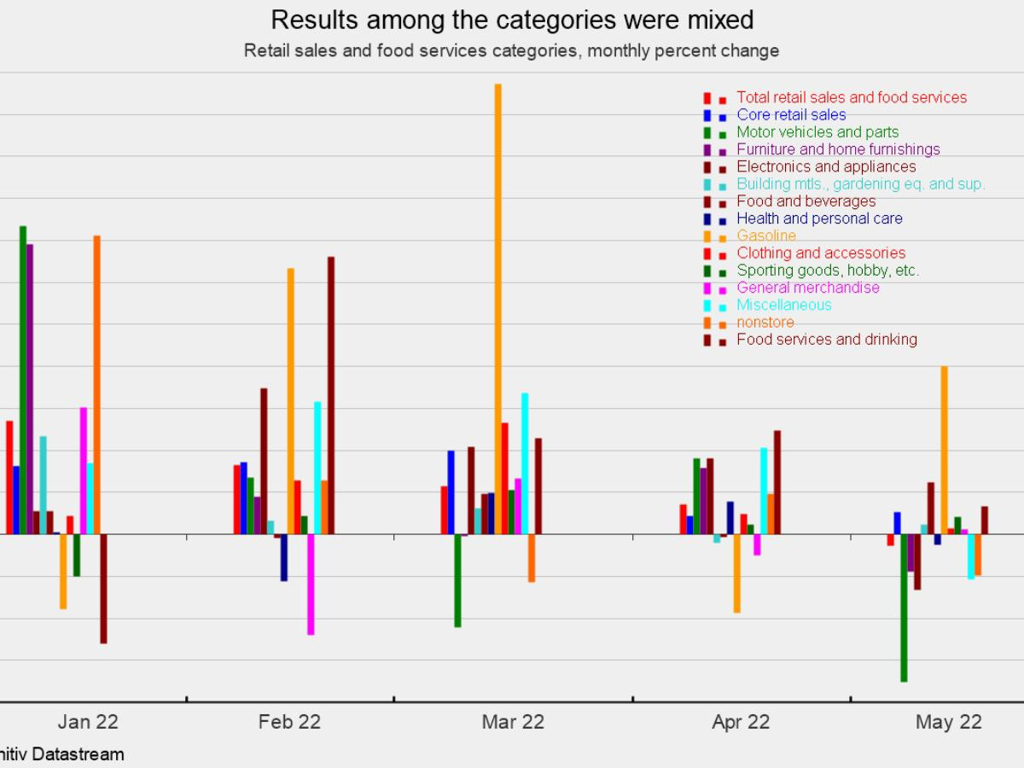
RESULTS
11

Slide 12
conclusion
In conclusion, retail and sales analysis is a crucial function for businesses to drive growth, improve efficiency, and enhance customer satisfaction.By leveraging data insights, retailers can:-
Optimize inventory levels and reduce waste.
Identify opportunities to increase sales and revenue.
Develop targeted marketing strategies.
Improve customer engagement and loyalty.
Inform strategic business decisions.

